Slide 1
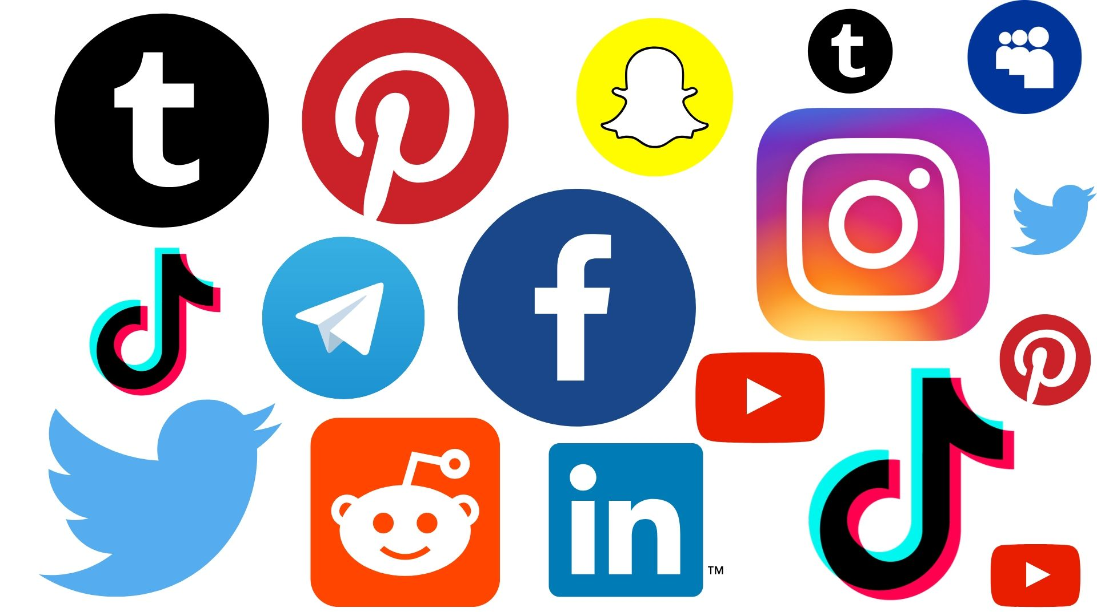
[ Image: The best social media platforms to use in 2023? - Gizchina.com ]
Notes:
Hi all , welcome to this chi 2024 talk about the content moderation policies of platforms that host user content.

Slide 2


“Community Guidelines Make this the Best Party on the Internet”:
An In-Depth Study of Online Platforms’ Content Moderation Policies
Brennan Schaffner
Arjun Bhagoji
Siyuan (Michael) Cheng
Jacqueline Mei
Jay L Shen
Grace Wang
Marshini Chetty
Nick Feamster
Genevieve Lakier
Chenhao Tan
Notes:
Titled “” Community Guidelines Make this the Best Party on the Internet”: An In-Depth Study of Online Platforms’ Content Moderation Policies
This was conducted by an ensemble of researchers from the university of Chicago

Slide 3
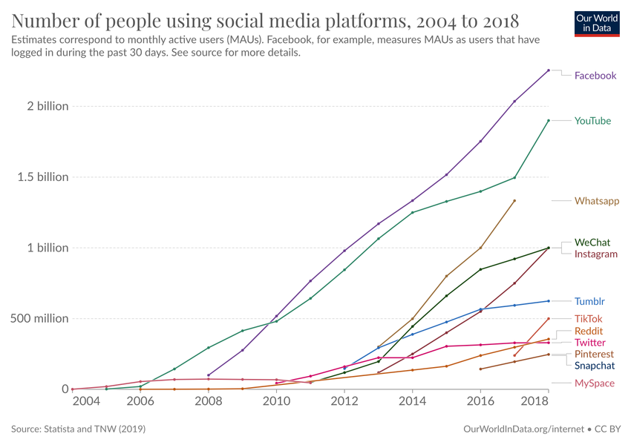
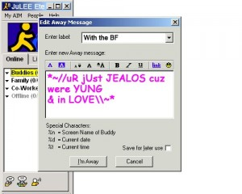
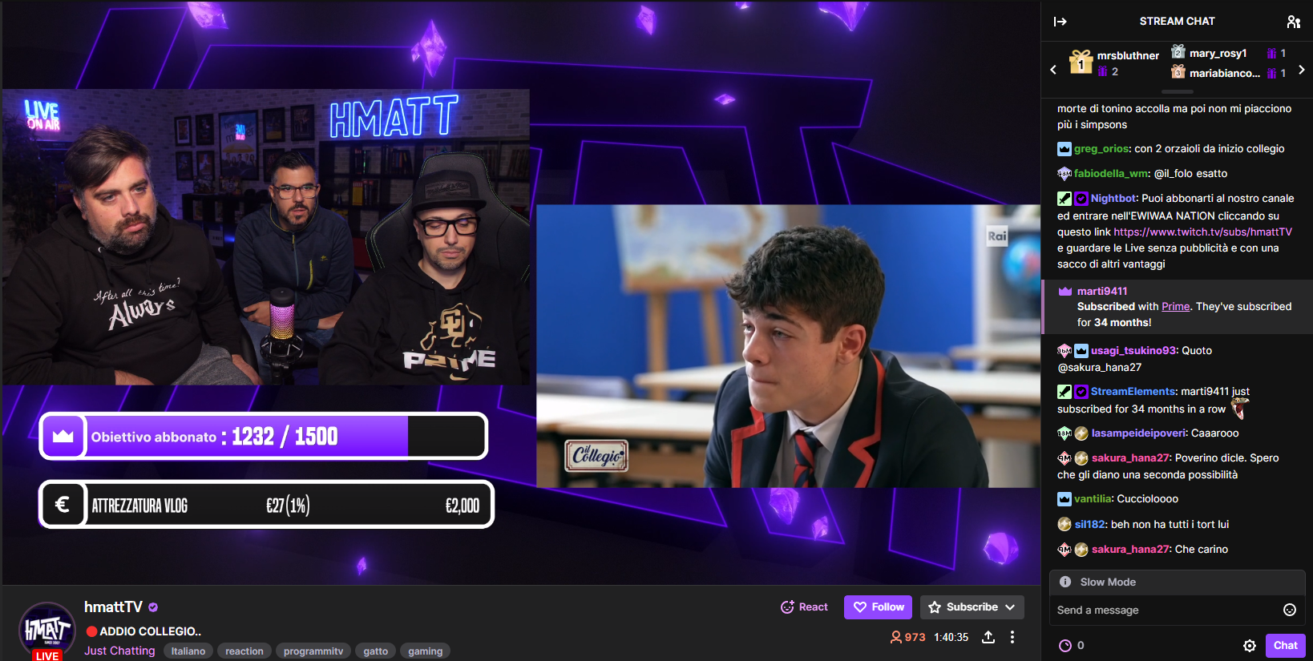
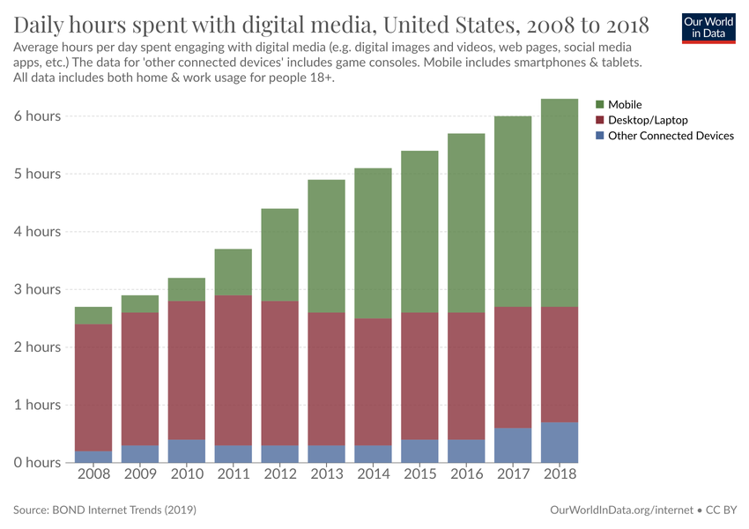
Complexity and scale of online content
Notes:
The internet is far from its age of plaintext messaging.
Online content takes many forms and operates at increasingly scales
For example, this screen capture of twitch shows a mix of media types with hierarchies of users, nested levels of video content, and several languages present.
This is accompanied by increases in users and time spent interacting with user generated online content.
So theres lots of content out there, and its complex. So Who is going to moderate all it?

Slide 4






Do governments define what is and is not allowed online?
[Section 230 (US)]
[Many other approaches]
[NetzDG, Section 130 (Germany)]
Notes:
First, do ~governments~ define what is and is not allowed online?
Section 230 is often said to be the law that allowed the internet to flourish and grow as it did, by not overly burdening platforms with content they didn’t create but were just hosting.
The many tensions at play here have been discussed to a large extent.
And The outcome has been that no major US laws provide “How To”s for platforms to moderated content.
Its become a matter of, If a platform acts in good faith to a reasonable extent to remove the worst stuff (such as trafficking and terrorism), then they wont be held liable for everything else on their platform
This is not the only way its done worldwide of course.
Just to give one more example for the sake of showing a small piece of the variety in relevant legal systems
In germany, there is law that specifically obliges platforms to remove illegal content within 24 hours or they will be fined. And they have accompanying laws that outlines what categories of speech fit within the legal and illegal boundaries.
This is in contrast to the rules for where most of the platforms we study are based, which is in the US, where in many cases the government does not define what is allowed, the platforms do.

Slide 5
Do governments define what is and is not allowed online?
[Section 230 (US)]
Step 1: Remove bad content
Step 2: Keep good content
Step 3: Try hard
[Digital Services Act (EU)]
[NetzDG, Section 130 (Germany)]
[Many other approaches]
Notes:
Section 230 , often attributed as the law that allowed the internet to flourish and grow as it did. By not overly burdening platforms with content they didn’t create but were just hosting.
Internet laws seem like they are constantly under attention as of recent. And There are a lot of tensions at play here.
The outcome has been that no major US laws provide “How To”s for platforms to moderated content.
If you act in good faith to a reasonable extent to remove the worst stuff (i.e. trafficking and terrorism), then we wont hold you liable for all the bad stuff
This is contrast to regulation outside the US. For example, in the EU, The DSA is meant to "govern the content moderation practices of social media platforms“ enacted starting in the new year. ( no such comprehensive thing exists for US)
Or in germany, there is law that specifically obliges platforms to remove “clearly illegal” content within 24 hours or they will be fined. And Germany also has relevant laws on which makes things like Hate Speech and Holocaust Denial “clearly illegal”.
And this isn’t the full picture. Austria and France I believe have some analog to the german laws., And the EU DSA interacts with the national laws like NetzDG of Germany in some complicated ways that I don’t fully understand
-we are not arguing that specific laws like those in Germany are better, just showing a little bit of variety in legal regimes that do exist, unfortunately just in the western context here. One could spend a lot of time going in depth on the various approaches that governments take in holding (or not) platforms liable for their content.
I digress a little, the main point being that in the US, where most of the platforms we study are based, the government does not define what is allowed, the platforms do.

Slide 6

In the US, platforms have implicitly become de facto regulators of almost all possible forms of human interactions online for major portions of the Internet
Notes:
And so.
Especially true in the US which remains as the main scope for the work

Slide 7
How do the platforms govern themselves?
Platforms have implicitly become de facto regulators of almost all possible forms of human interactions online for major portions of the Internet.
Notes:
Which begs the question
To dive into this landscape, we take the following apptoach

Slide 8
Approach
Analyze the platforms’ stated policies when it comes to moderating content
3 Moderation Topics with different intensities of existing relevant legal structures:
Copyright Infringement
Very Structured;
Well-established
[DMCA]
Hate Speech
Hard to distinguish;
Varies over time and place;
Difficult to define;
First Amendment exists
[Inciting Violence]
[Anti-discrimination]
Misinformation
No consensus on “truth”;
Lack of institutional trust;
‘Newer’ cases of global harms;
Sporadic edge-case laws;
[False Ads]
[Market Fraud]
[Defamation]
[Counterfeit]
Notes:
We sought to gather and analyze the policies that the platforms have created to moderate the content on their sites.
We focused on 3 popular moderation topics, each with differing groundings with legal structures in the US
First we have Copyright , which is very structured, well-established
The Digital millenium copyright act in the US outlines in detail the legal considerations and responsibilities of platforms and users with respect to hosting potentially infringing material
We then looked at hate speech moderation , which itself can be more nuanced. Hate speech faces challenges to moderation by being harder to pin down at times.
Some specific laws exist in the US that touch on similar issues but nothing that covers general hateful speech on the internet
We also looked at misinformation, which can also be nuanced and often lacks consensus. , There are some edge case laws but nothing close to the boilerplate specifics that outline for example, copyright infringement.
These topics allowed us to focus on three relatively siloed areas that are each rooted in different levels of legal structures and have reached public attention at different recencies.
% That being said, there are other topics CSAM that could be interesting in the future work could cover

Slide 9
Where do we look?
Study Outline
facebook.com
youtube.com
instagram.com
twitter.com
linkedin.com
wikipedia.org/wikimedia
amazon.com
pinterest.com
github.com
reddit.com
vimeo.com
wordpress.com
msn.com
tiktok.com
xvideos.com
tumblr.com
pornhub.com
nytimes.com
flickr.com
fandom.com
ebay.com
imdb.com
medium.com
soundcloud.com
aliexpress.com
twitch.tv
stackoverflow.com
archive.org
theguardian.com
bbc.co.uk
xhamster.com
quora.com
w3.org
sourceforge.net
indeed.com
etsy.com
sciencedirect.com
booking.com
imgur.com
spankbang.com
researchgate.net
washingtonpost.com
xnxx.com
Top 200 sites (Tranco)
-> 43 sites with
User Generated Content (UGC)
Focus on the 3 moderation topics:
Copyright Infringement
Hate Speech
Misinformation
We: 1) Collect, 2) Annotate, and
3) Analyze the relevant policy text
Notes:
So Heres what we actually did
Some Past work has mostly just focused on one area or one site.
But looking at many sites and multiple areas gives us a broader view of the state of content moderation for these major platforms.
This Collect, annotate, and analyze methodology leads straight into our main contributions.

Slide 10
Contribution Preview
[Collect] Open-source pipeline
Configurable web-scraper to collect a targeted set of policy passages
[Annotate] Open-source dataset (OCMP-43):
Large dataset of annotated content moderation policies
[Analyze] Policy themes from the Internet’s biggest content hosts
An example takeaway:
Platforms explain what they moderate mostly by giving examples rather than definitions
Notes:
In sum,
We developed a pipeline for finding and scraping relevant content moderation policy text from the platforms.
Check out the paper for more details on this scraper and pipeline. Ill leave out those details for this presentation.
We then developed an annotation scheme and annotated our dataset of content moderation policies.
We then conducted some analysis of the annotated datasets to glean insights about the state of moderation from the internet’s largest hosts of user content.
For example we found that platforms tended to explain their moderation criteria via examples rather than explicit definitions.
Lets look at these in a bit more detail

Slide 11
Contribution: Annotated Dataset
Large dataset of annotated policy text pertaining to copyright, misinformation, and hate speech for the 43 largest UGC platforms
Notes:
We created and annotated this dataset
Make sure to say user generated content

Slide 12
Contribution: Annotated Dataset
Annotation Example
We believe in the value of allowing for discussion of important issues of public relevance to happen and this often includes critical commentary. Therefore, we may allow critical commentary of public figures as long as it does not constitute harassment or abuse. Read More Hateful and Discriminatory Speech We do not allow hateful and discriminatory speech. We define this as any expression that (1) is directed to an individual or group of individuals based upon personal characteristics of that individual or group; (2) conveys a message of inferiority or contempt; and (3) would be considered extremely offensive to a reasonable person.
Justification: Community, Trust, & Safety
Moderation Criteria: Exceptions
Moderation Criteria: Example
Moderation Criteria: Definition
Signpost
Notes:
Here is an excerpt from the dataset showing a subset of the annotation scheme.
First lets look at a few of the labels we applied. We iteratively constructed the annotation scheme to refer to the different major components that policies can contain.
For example, we have Justification labels for Why a platform has a policy.
And Moderation Criteria lables for when certain policies apply, as well as its more granular subcategories.
We also include structural labels like Signpost applied when policy text is referrering or pointing the reader to information elsewhere.
The full codebook can be found in the paper.
And returning to this passage shows us an example of how the codebook can be used.
The first sentence provides justification for the platforms moderation policy on the basis of community values.
The next sentence provides an exception to the more general rule. Followed by a signpost link to read more.
The policy then outlines the criteria for moderation first with an example and then some definitions.
And so we did this for all of the relevant policy passages. Resulting in

Slide 13
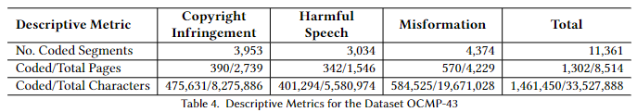
Contribution: Annotated Dataset
> 1,300 annotated policy pages
> 11,000 annotated segments
> 1.4 million annotated characters
Notes:
A quite large dataset of annotated policy text.
It includes …
As you can see, this too a lot of manual effort from a team of 4 annotators.
The result is a powerful dataset. Annotation at this scale enables interesting analysis of the current state of content moderation. Which brings me to the analysis part of our contribution

Slide 14
Contribution: Analysis
Mixed-methods analysis of policy content, structure, and coverage using the annotated dataset
Notes:
Here I will show a select few of the questions we were able to answer through analysis of the dataset

Slide 15
Why do platforms moderate?
Moderation Topic | Policy Justification
Copyright | Legal (≈79%)
Hate Speech | Community, Trust, & Safety (≈83%)
Misinformation
“Our users, as decent human beings, don’t like that kind of thing.”
(Hate and Harassment section of tumblr.com’s Global Advertising Policy)
Notes:
First, Why did platforms say they moderated content. We thought of this as the platforms providing justification for their stated policies.
The results match expectations, Copyright Infringement policies cite legal justifications.
In other areas, where laws are less present, platforms look to upholding standards and values

Slide 16
(When) do platforms take a deeper look at flagged content?
Moderation Topic | Portion of Investigation Policies
Copyright | ≈15%
Hate Speech | ≈85%
Misinformation
“GitHub Isn’t The Judge. GitHub exercises little discretion in this process other than determining whether the notices meet the minimum requirements of the DMCA. It is up to the parties (and their lawyers) to evaluate the merit of their claims.”
(github.com’s DMCA Guide)
“Twitch will consider a number of factors to determine the intent and context of any reported hateful conduct.”
(twitch.tv’s Community Guidelines)
Notes:
What about after content is flagged for potential moderation, when to platforms take a deeper look?
For copyright, platforms play a small role in simply making sure requests meet the requirements, but as shown in this excerpt from github’s policy, the tough decisions are reserved for the other parties involved.
As for harmful speech and misinformation, intent and context are often necessary for making the right call, and this investigation is typically done so by the platform.

Slide 17
Can users appeal moderation?
“If you have received a Digital Millenium Copyright Act (DMCA) Infringement Notice and believe it was submitted in error, you may submit a counter notice.
(automattic.com’s Online DMCA Counter Notice Form)
Moderation Topic | Portion of Appeal Policies
Copyright | ≈75%
Hate Speech | ≈25%
Misinformation
“To the fullest extent permitted by applicable law, your only remedy with respect to any dissatisfaction with (i) the Services, (ii) any term of these Terms of Use, (iii) any policy or practice of Fandom in operating the Services, or (iv) any content or information transmitted through the Services, is to terminate your account and to discontinue use of any and all parts of the Services.”
(Fandom ToS)
Notes:
Specific instances of content moderation may be inconsistent with a platform’s stated policies [43] and/or user expectations, leading users to seek rollback of moderation.
We looked to see when this was possible.
Most instances of appealing policeis were fore copyright infringement. And as you can see the dmca provides specific forms that users can submit to contest moderation.
But when it comes to hatespeech and misinformation, there is little users can concretely do . As you can see with this quote from fandom. >>
This imbalance suggests that more work may need to be done to help users know what actions they can take if they feel their content has been unfairly moderated as harmful or misleading

Slide 18
How comprehensive are policies across platforms?
Policy Components we used to gauge completeness:
Moderation Criteria
Policy Justification
Prevention & Detection
Enforcement & Response
Appeal Information
Only ≈30% (13/43) platforms were complete in terms of policy composition
Notes:
We also looked at the components of our annotation scheme altogether
We consider a platforms policies complete if it includes proper explanation of Moderation Criteria, Policiy Jusification, …

Slide 19
Takeaway Summary
Copyright Infringement policies cite legal justifications.
In other areas, where laws are less present, platforms look to upholding standards and values
Platforms investigation

Slide 20
Lookahead for Stakeholders
1. Regulators
Policies scattered and unclear
-> Standardizing policy formats and language
2. Platforms
Use dataset to evolve best practices
3. Researchers
Using our pipeline and scraper to expand our dataset
Further usage and analysis of our dataset
Overall improve methods of annotating policies
Notes:
This work has a number of implications for the different stakeholders involved.
First, for regulators:
There is a difficulty in locating policy text, let alone interpreting it. This points to a need for dialogue between platforms and regulators to agree upon standardization around content moderation policy.
Standard locations for policies, as well as (possibly even machine-readable) policies, could make it easier for regulators to check that stated policies comply with the laws of a particular region. In its current state, its difficult to know if platforms are following their own policy or laws (where the do exist).
As for platforms, this is the first such dataset of policy text from an array of different platforms.
Our work might help platforms analyze their own policies in the context of the wider industry.
Finally, for researchers there are a number of possible takeaways and possible extensions.
Our pipeline and scraper could be used to expand our dataset for additional types of platforms, such as news sites around the world, or reconfigured to focus on additional content moderation topics like. “ how do plaforms regulate AI generated content “ ?
B. Our current
findings provide a comprehensive high-level overview of why,
when, and how platforms moderate, but additional insights could be
extracted from the dataset aswell. For instance, future studies could further
contrast moderation policies for different types of users. Think about nytimes.com, they have policies specifically for
journalists, advertisers, in addition to regular users, all of whom use the platform in different ways, and are governed in unique ways
C. Or maybe, there are some ways to explore annotation improvement. It is unfortunate that so much manual work has to be done in order to do an overdue study like this one. LLMs seem to be the current likely candidates for these types of studies.

Slide 21

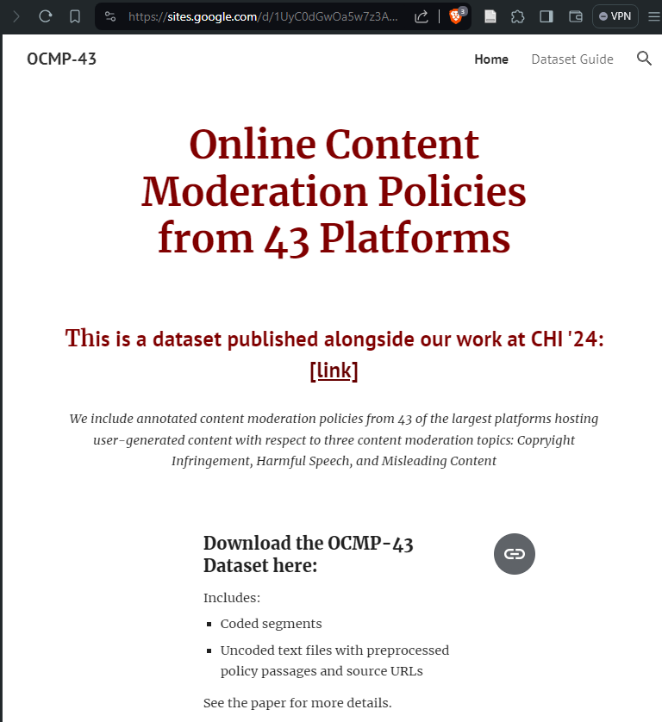
ocmp43.cs.uchicago.edu
“What does TikTok (report they) do about misinformation?”
“Related to the elections: We may not take action on violating content that is deemed newsworthy.”
(tiktok.com’s Election Integrity Policy)
Next: Do platforms adhere to their reported policies?
Notes:
One final note, Our dataset is public
We tried to…
You could…
In this study we looked at what platforms report they do
And the next steps are to see if they actually do it

Slide 22
“Community Guidelines Make this the Best Party on the Internet”:
An In-Depth Study of Online Platforms’ Content Moderation Policies
Brennan Schaffner
Arjun Bhagoji
Siyuan (Michael) Cheng
Jacqueline Mei
Jay L Shen
Grace Wang
Marshini Chetty
Nick Feamster
Genevieve Lakier
Chenhao Tan
Notes:
Thank you for your time

Slide 23
Social Media platforms host content online
[citation needed]
Notes:
wohoo! Free speech! The internet solves all our problems;
Okay lets step this up a little

Slide 24
As a society, we want platforms to host good online content

Slide 25
But what is good online content?
- Hard to say…
- Not good:
- CSAM,
- IP infringement,
- hate speech,
- spam,
- incitements to violence,
- …
Notes:
Some periphery laws in this space

Slide 26
Approach
Analyze the rules and policies by which platforms govern themselves
3 Moderation Topics with different intensities of existing relevant legal structures:
Copyright Infringement
Very Structured;
Well-established
[DMCA]
Hate Speech
Hard to distinguish;
Varies over time and place;
Impossible to define;
First Amendment exists;
Deep-rooted
[Inciting Violence]
[Anti-discrimination]
Misinformation
Sporadic edge-case laws;
No consensus on “truth”;
Lack of institutional trust;
‘Newer’ cases of global harms
[False Ads]
[Market Fraud]
[Defamation]
[Counterfeit]
We:
Gather relevant Content Moderation Policies for the largest online platforms
2. Analyze what the policies say
Notes:
Yes – we know there are other topics, like CSAM and GORE , etc. but we wanted to focus on three relatively siloed areas that are each rooted in different levels of legal structures and have reached public attention at different recencies.

Slide 27
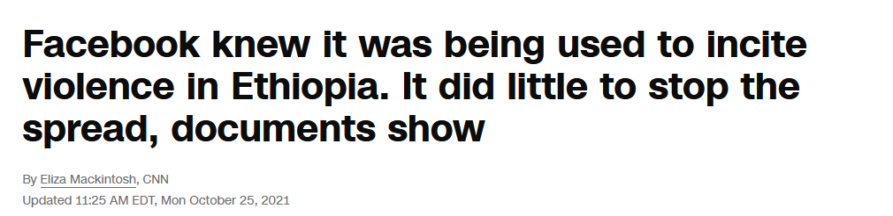
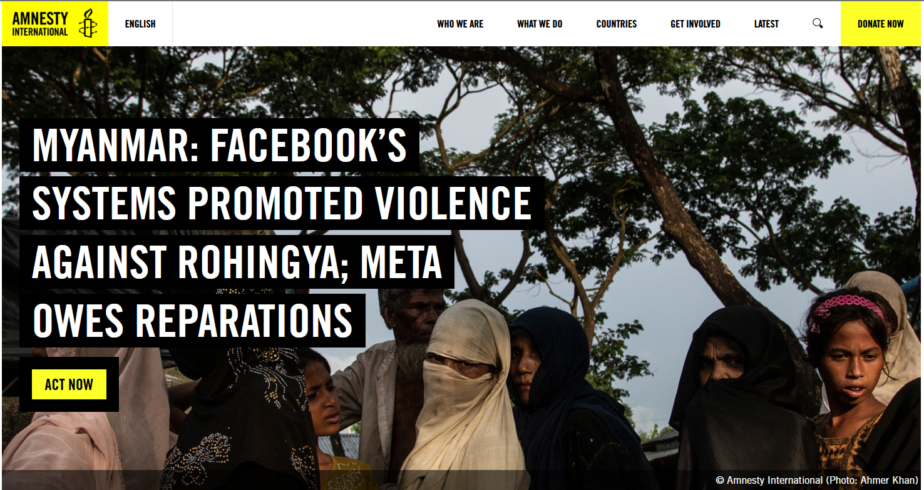
Can we trust them to regulate?
Notes:
Out of place ish

Slide 28
Outline of our Study
Look at Content Moderation Policies for the biggest platforms
What do the policies say? (w.r.t. copyright, misinformation, and hate speech)

Slide 29
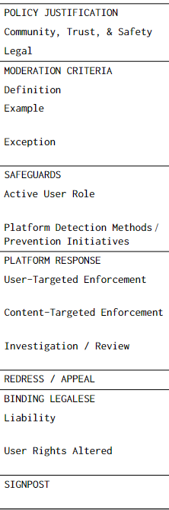
What do we look for?
Outline of our Study
Why
(have the policy)
What
(gets moderated)
How
(violative content is found)
Annotate the policies
with our annotation scheme
(Manually)
How
(is moderation conducted)
Then What
(can users do in response)
Who
(is liable/responsible)
Structural
(navigation/references around policy text)

Slide 30
Contribution 1: Dataset
Glimpse into the dataset:
“Example: ‘If I don't hear from you by tomorrow about the item I purchased, I will come over to your house and break your legs.’” (Ebay)
“Political news and events can be subject to misinformation, so the availability of quality information sources is crucial. That’s why we raise up authoritative voices , including news sources like CNN and Fox News, for news and information in search results and “Up next” panels.” (YouTube)
“What we’re doing in response to the interference: First, we’ll be emailing anyone who liked, reblogged, replied to, or followed an IRA-linked account with the list of usernames they engaged with. Second, we’re going to start keeping a public record of usernames we’ve linked to the IRA or other state-sponsored disinformation campaigns.” (tumblr.com’s Official Staff Blog)

Slide 31
Contribution 2: Pipeline
Configurable web-scraper to collect policy passages from pages

Slide 32
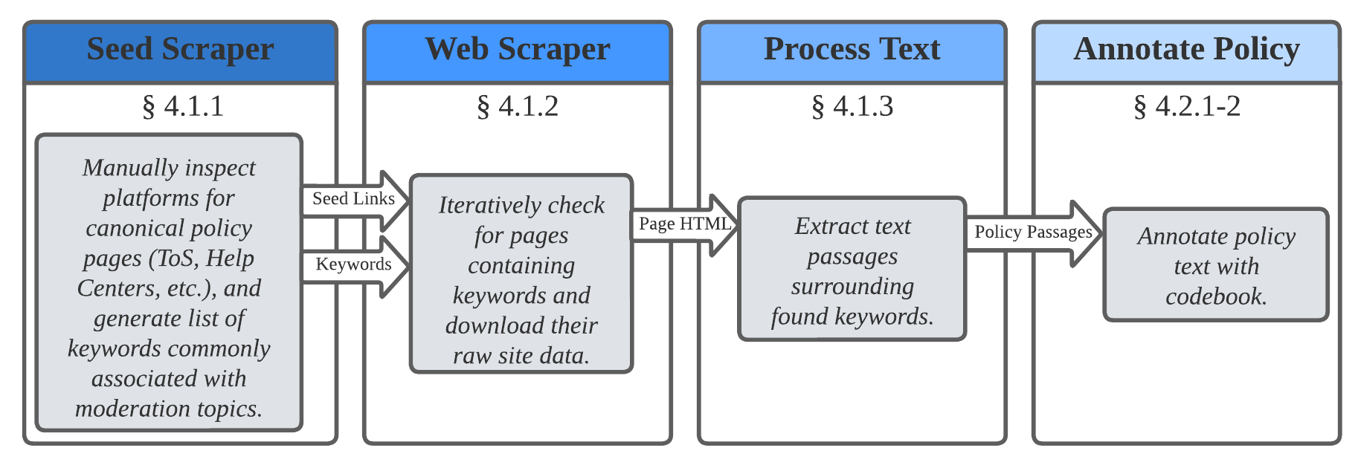
Contribution 2: Pipeline
Notes:
General goal: cast a wide net

Slide 33
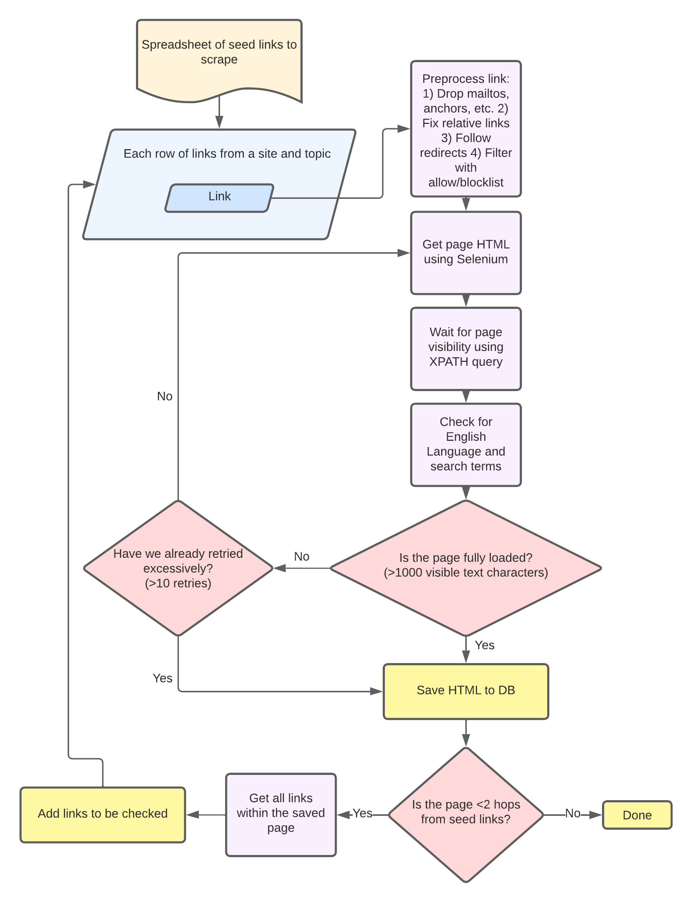
Web-Scraper Logic
Notes:
Highlight pain points
Not perfect but best we found (especially for free)
Even so, we did end up having to manually scrape about 100 pages . So it worked 99% of the time.
Our keyword approach casted a wide net, especially when capturing footers, and menu options. But we didn’t want to miss anything, so we let this go until the annotation stage.

Slide 34
We created the dataset (Contribution 1) by using the pipeline (Contribution 2) -> we learned the following… (Contribution 3)
Notes:
In sum, quick. To check back where we are. ….
The dataset allowed us to make discoveries about content moderation policies .

Slide 35
Why scrape and annotate policies?
facebook.com
youtube.com
instagram.com
twitter.com
linkedin.com
wikipedia.org/wikimedia
amazon.com
pinterest.com
github.com
reddit.com
vimeo.com
wordpress.com
msn.com
tiktok.com
xvideos.com
tumblr.com
pornhub.com
nytimes.com
flickr.com
fandom.com
ebay.com
imdb.com
medium.com
soundcloud.com
aliexpress.com
twitch.tv
stackoverflow.com
archive.org
theguardian.com
bbc.co.uk
xhamster.com
quora.com
w3.org
sourceforge.net
indeed.com
etsy.com
sciencedirect.com
booking.com
imgur.com
spankbang.com
researchgate.net
washingtonpost.com
xnxx.com
What are some things we can learn from the dataset?
Return to our comparisons across Moderation Topics and the 43 platforms:
Copyright Infringement
Hate Speech
Misinformation

Slide 36
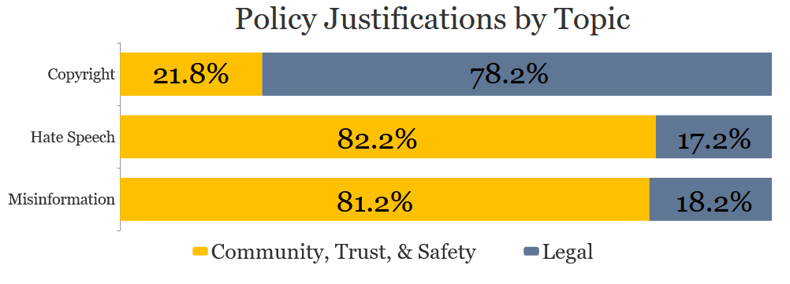
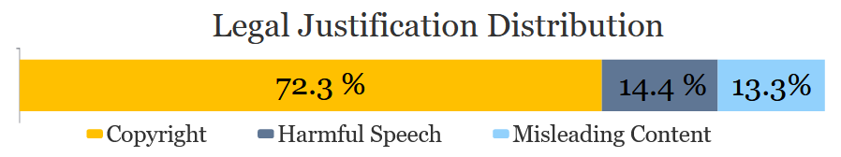
Why do platforms moderate?
“Our users, as decent human beings, don’t like that kind of thing.”
(Hate and Harassment section of tumblr.com’s Global Advertising Policy)
Notes:
Most deeply rooted in our core motivation. The results match expectations, legal Topics cite legal justifications.
Where laws are lacking, platforms look to upholding standards and values
NUMBERS DONT MATCH PAPER

Slide 37
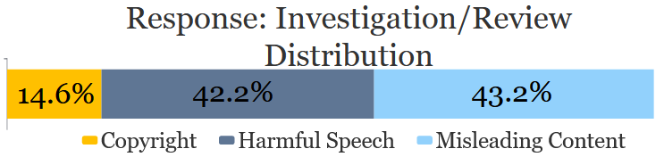
(When) do platforms take a deeper look at flagged content?
GitHub Isn’t The Judge. GitHub exercises little discretion in this process other than determining whether the notices meet the minimum requirements of the DMCA. It is up to the parties (and their lawyers) to evaluate the merit of their claims.”
(github.com’s DMCA Guide)
Twitch will consider a number of factors to determine the intent and context of any reported hateful conduct.”
(twitch.tv’s Community Guidelines)
Notes:
But looking at investigation…

Slide 38
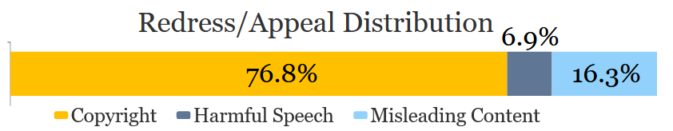
Can users appeal moderation?
“If you have received a Digital Millenium Copyright Act (DMCA) Infringement Notice and believe it was submitted in error, you may submit a counter notice. Counter notices must be submitted by theWordPress.com user who uploaded the material. You may also use the form below to submit a DMCA counter notice:”
(automattic.com’s Online DMCA Counter Notice Form)
“To the fullest extent permitted by applicable law, your only remedy with respect to any dissatisfaction with (i) the Services, (ii) any term of these Terms of Use, (iii) any policy or practice of Fandom in operating the Services, or (iv) any content or information transmitted through the Services, is to terminate your account and to discontinue use of any and all parts of the Services.‘’
(Fandom ToS)
Notes:
Specific instances of content moderation may be inconsistent with a platform’s stated policies [43] and user expectations, leading users to seek rollback of moderation. However, we find that there is little users can concretely do unless they ortheir content was targeted on the basis of copyright infringement.
This imbalance suggests that more work may need to be done to help users know what actions they can take if they feel their content has been unfairly moderated as harmful or misleading

Slide 39
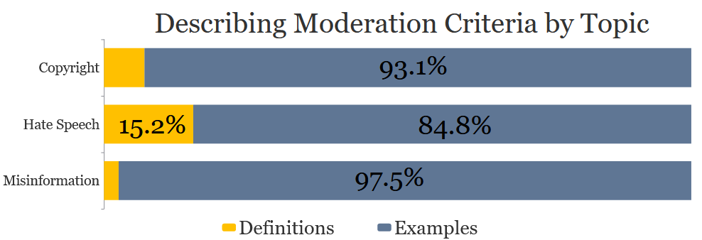
How do platforms describe what they moderate?
“Hate speech is defined as a serious attack on a group or individual based on their race, ethnicity, gender, nationality, sexual orientation, sex, religion, caste, serious medical condition, or disability. [...]
Examples include: - Statements like ‘⟨insert race/ethnicity⟩ are not welcome in our country’.”
(quora.com’s Platform Policies)
Notes:
Platforms need to clearly specify what is likely to get moderated, and what is not, since this provides clarity to users, fostering healthy communities [ 35 ]. However, across all three topics, we found that platforms established what they were likely to moderate using Examples, instead of Definitions.

Slide 40
How comprehensive are policies across platforms?
complete = platform that contains at least some policy text pertaining to each of the subcodes under Policy Justification, Moderation Criteria, Safeguards, Platform Response, Redress/Appeal
Only 30.2% (13/43) platforms are complete in terms of policy composition
Notes:
Worked our way through the process , how about altogether

Slide 41
The Internet is Messy
Policies scattered across platforms.
Most policy is found in ToS, Community Guidelines, and Help Centers
Location Observations:
79% (34/43) of platforms have page(s) dedicated to Community Guidelines; only 12 of which are linked directly from the platform’s Home Page
84% (36/43) of platforms have Help Centers; almost all are found on Home Page
Some other locations we found relevant policy (not exhaustive): Transparency Centers, privacy pages, advertising policy pages, developer documentation, and seller policies, blog posts, internal newsrooms, etc.
Constant arms race between bots and bot-blockers
Tons of policy text that’s irrelevant for us
->How did we actually collect this data?
Notes:
Contributes to argument about standardizing some of the mess of the internet and also motivates why we had to do what we did in developing our own scraper

Slide 42
Questions?

Slide 43
Extra Slides

Slide 44
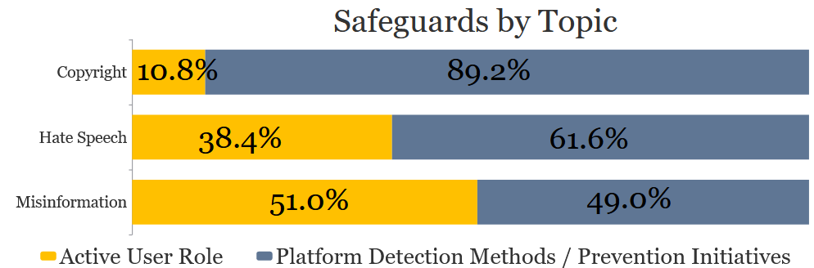
How do platforms find content that may need moderation?
“Pornhub moderates user-uploaded content in three major ways: through the use of automated detection technologies, through real-life human moderators, and through user-generated reports.”
(pornhub.com’s Help Center)
Notes:
In order to detect and then subsequently act upon content that may need to be moderated, we find platforms in general largely use three methods: automated detection, human moderators, and users flagging content, as summarized by this representative quote:
NUMBERS DONT MATCH PAPER

Slide 45
How do platforms find content that may need moderation?
Misinformation is different from other types of speech addressed in our Community Standards because there is no way to articulate a comprehensive list of what is prohibited. With graphic violence or hate speech, for instance, our policies specify the speech we prohibit, and even persons who disagree with those policies can follow them. With misinformation, however, we cannot provide such a line. The world is changing constantly, and what is true one minute may not be true the next minute.”
(facebook.com’s Community Standards on Misinformation)
Notes:
Takeaway: Often rely on users, depending on the topic
NUMBERS DONT MATCH PAPER

Slide 46
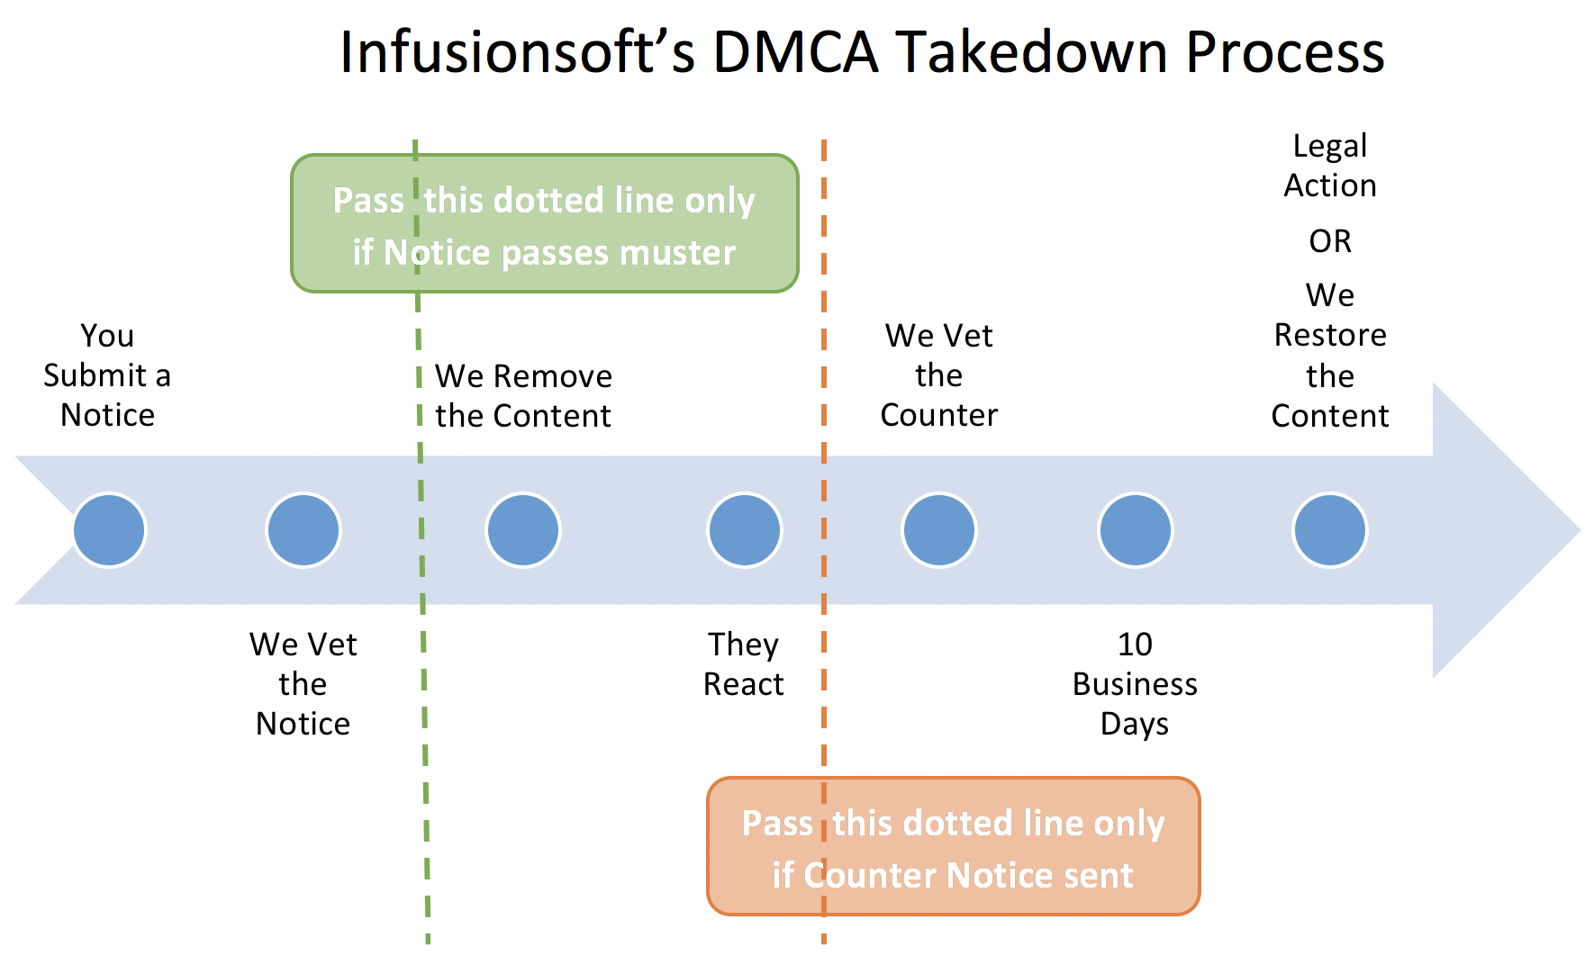
Typical DMCA process

